Slide 1
ECE 498 MP3 Report Template
Spring 2018
<Group Number> : <NetIDs>

Slide 2
Task 1 – HTTP Traffic Analysis
First Attempted Scan:
IP Address of Vulnerable Server:
Port of Vulnerable Server:

Slide 3
Task 1 – HTTP Traffic Analysis
Number of unique content type headers:
Average and Maximum Lengths:
Table from Subtask 2.b

Slide 4
Task 1 – Host Log Analysis
List of kernel modules:
Attacker controlled module:
How did you verify the attacker controlled module was loaded?
How did you verify that the secret key was read from the server?

Slide 5
Task 1 – DNS Traffic Analysis
Attacker controlled DNS server:
Legitimate DNS server:
Histogram of length of queries for both servers:

Slide 6

Task 2 – Simple Factor Graph
Marginal Probability $P\left(S_{1}\right)$:
Value of $S_{1}$ that maximizes $P\left(S_{1}\right):$
Hand calculations:

Slide 7
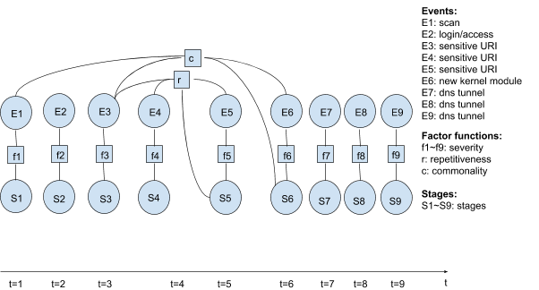
Task 3 – Factor Graph Inference
Image of factor graph defined in your code:

Slide 8
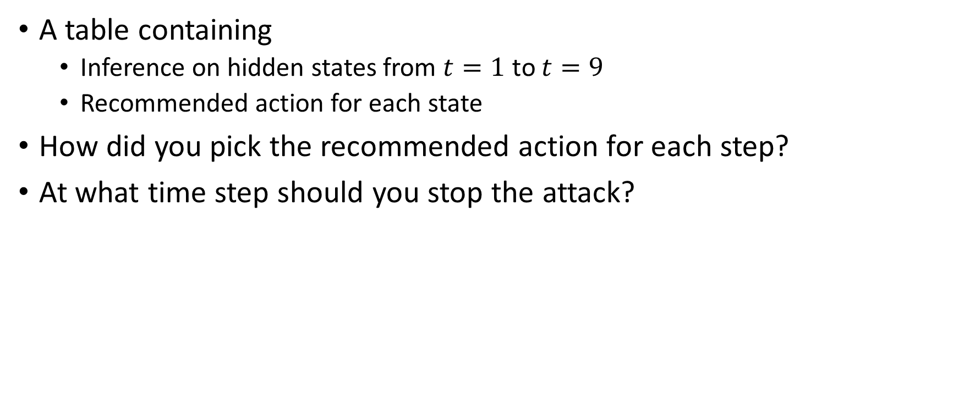
Task 3 – Factor Graph Inference
A table containing
Inference on hidden states from $t=1$ to $t=9$
Recommended action for each state
How did you pick the recommended action for each step?
At what time step should you stop the attack?

Slide 9
Task 4
Image of factor graph

Slide 10
Highlight elements common to the factor graph in Task 3
To add a new event to your factor graph, what additional information is required?

Slide 11
Breakdown of Contribution
Member 1 (Overall percentage of work):
Task A
Task B
Most of Task C
Member 2 (Overall percentage of work):
Task C
Task D
Report
Member 3 (Overall percentage of work):
Helped member 1 with Task A

